Slide 1


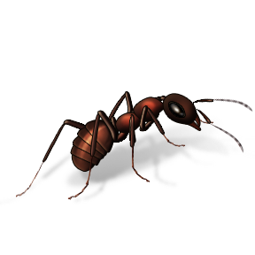

A
apple
alligator
angel
ambulance
airplane
ant
astronaut

Slide 2




B
bat
balloons
butterfly
boat
book
bus
basketball
bear
bee
bananas

Slide 3

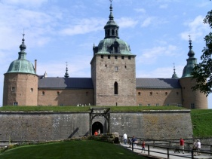

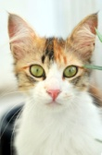
C
cat
cage
cow
cup
crab
clown
crown
castle

Slide 4

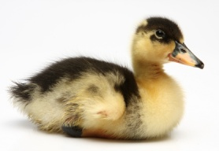
D
dog
donut
diamond
dough
dentist
drum
dinosaur
dolphin
duck
donkey

Slide 5
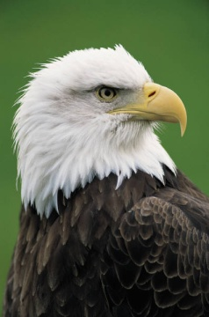
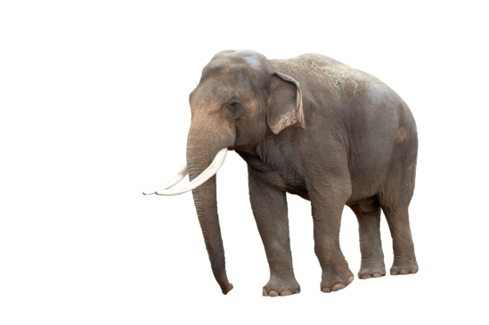
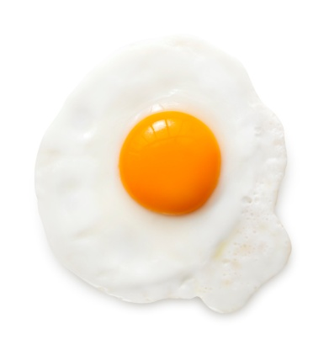
E
egg
elf
eagle
elephant

Slide 6
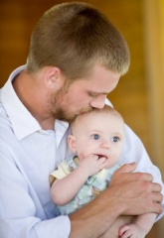



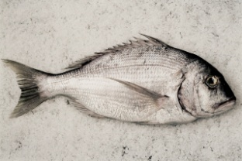
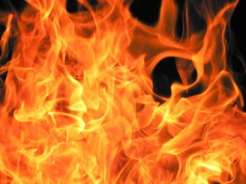
F
father
fall
fish
fire
farmer
frog
flower
football
flag
fox
firefighter

Slide 7

G
goat
grapes
gorilla
giraffe
ghost
grasshopper

Slide 8


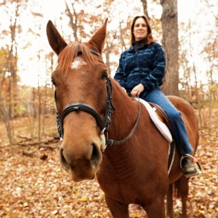
H
horse
heart
hat
house
hippopotamus
helicopter

Slide 9


I
igloo
ice
ice cream
insects
iguana

Slide 10
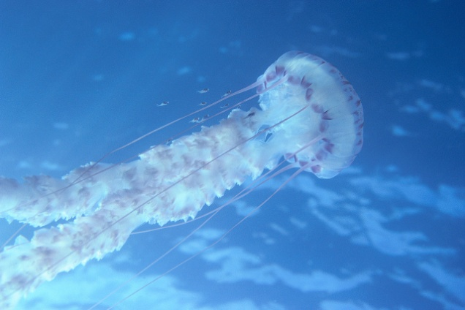
J
jet
jar
jellyfish

Slide 11
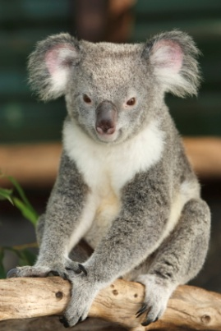
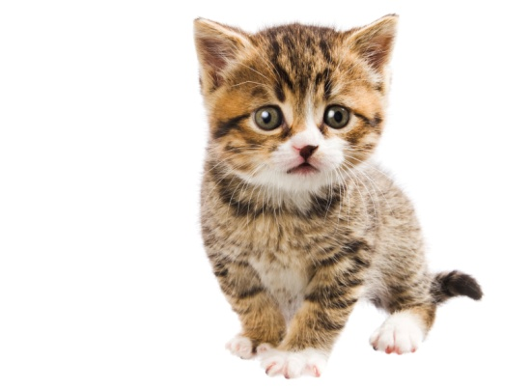
K
king
kite
koala
kitten
kangaroo

Slide 12

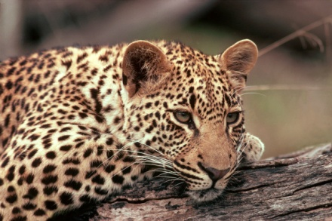

L
lion
lamb
ladder
lantern
leopard
ladybug
lamp

Slide 13


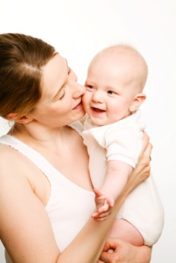
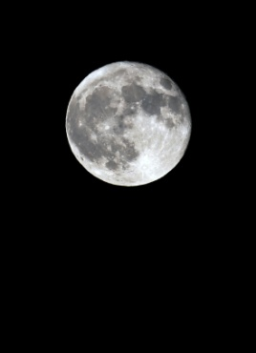
M
mouse
mouse
mother
monkey
moose
moon
mailbox

Slide 14

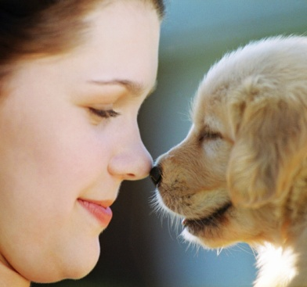
N
nest
nose
numbers
nurse

Slide 15


O
owl
oval
ostrich
ocean
octopus

Slide 16
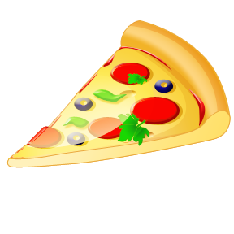

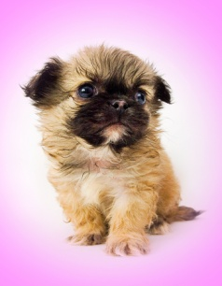



P
pot
pig
panda
pizza
picnic
pineapple
police
piano
puppy
pumpkin
penguin

Slide 17
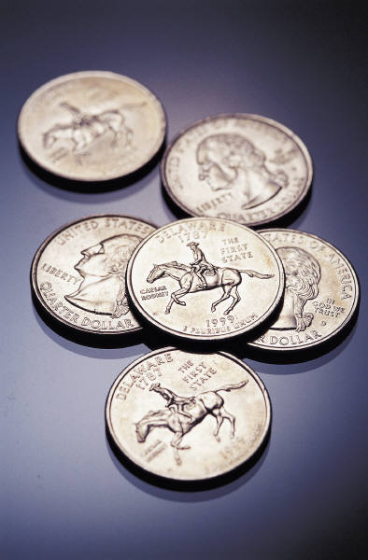

Q
quilt
quail
quarter
queen

Slide 18

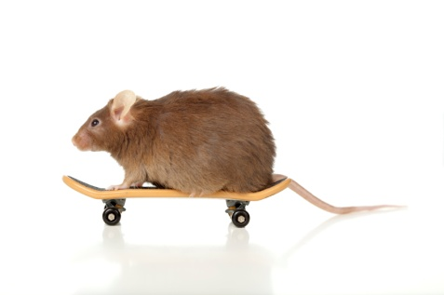
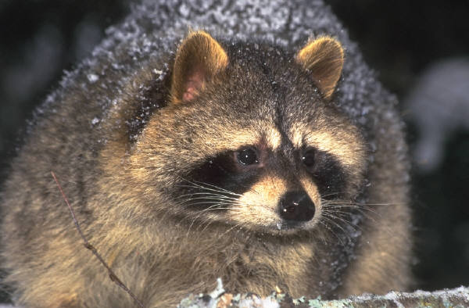
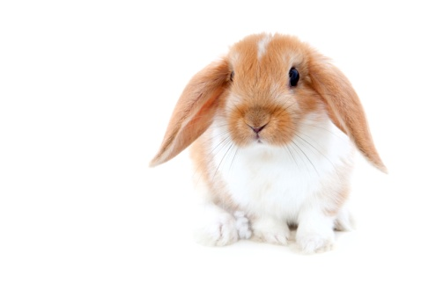
R
rat
rose
rooster
rabbit
raccoon
recycle
reindeer

Slide 19



S
slide
snake
snail
sun
spider
star
snow
swing
school
squirrel

Slide 20
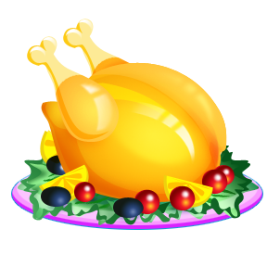

T
tree
turtle
tiger
turkey
tractor

Slide 21


U
umbrella
unicorn
United States

Slide 22
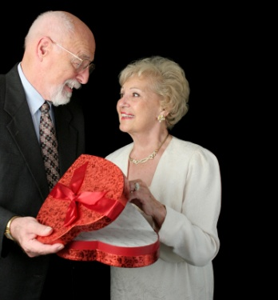


V
van
violin
vulture
volcano
vegetables
vine
valentine

Slide 23

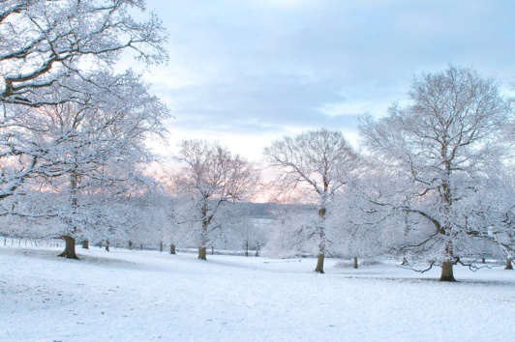
W
water
wagon
wolf
whale
watermelon
winter
wizard

Slide 24
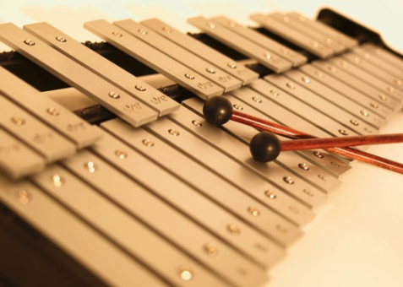
X
x-ray
xylophone

Slide 25

Y
yarn
yoyo
yak
yacht
yellow

Slide 26

Z
zipper
zebra
zigzag
zero
zoo

