Slide 1
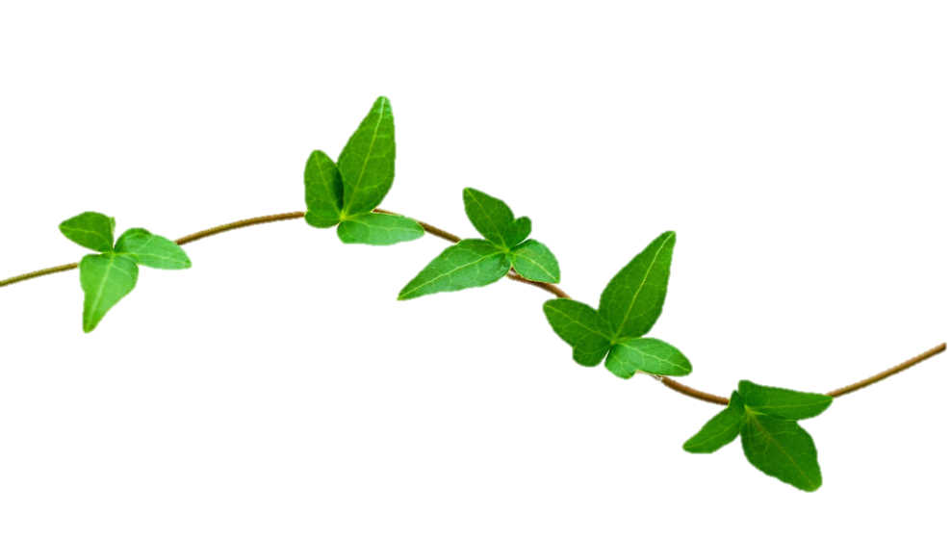


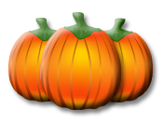

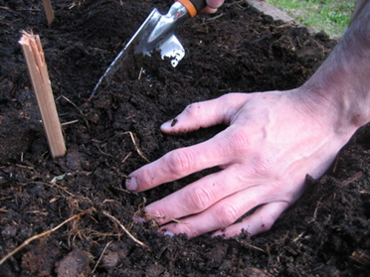
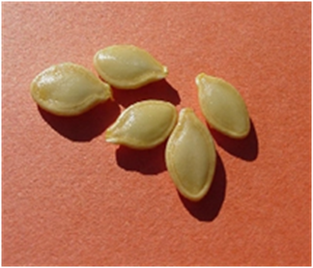
Name
Pumpkin Life Cycle
The seeds are planted in the soil.
Notes:
Tip: I would have the PPT up so that the students can see exactly where to drag and drop the pictures on the page. After printing, have them cut and assemble books. Double-click on “Name” to select and then let the student type in their name.

Slide 2

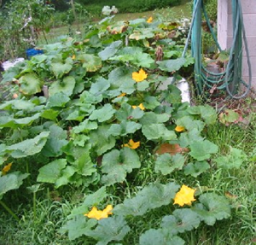
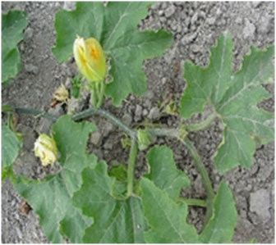
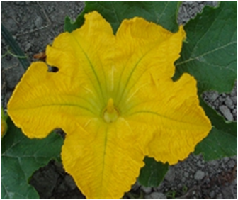
The vine grows in the sun.
A flower blooms on the vine.

Slide 3
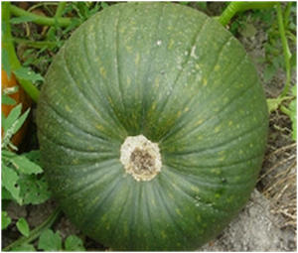
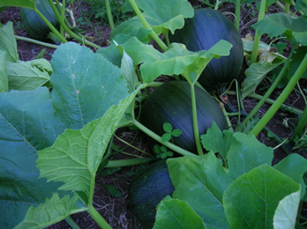
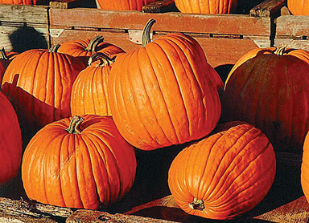
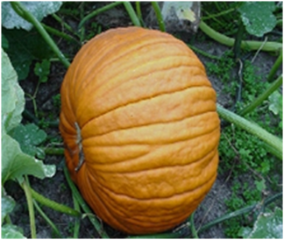
A green pumpkin grows on the vine.
The pumpkin will turn orange when it is ripe.

