Slide 1
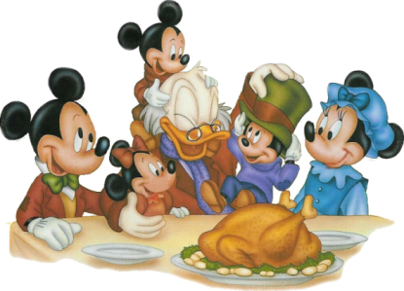
Turkey Bingo
Notes:
Tip: Double-click inside the name box and type to add a name.

